Slide 1
Please download all the materials from Week 11 > Thursday

Slide 2
Temporal Data II (Pandas + Analysis) SI370
March 16, 2017
Eytan Adar

Slide 3
Last Time: Temporal data I
What is temporal data?
How do we visualize it?
Time series
Clustering
Event-driven analysis
Manipulation
Pandas examples

Slide 4
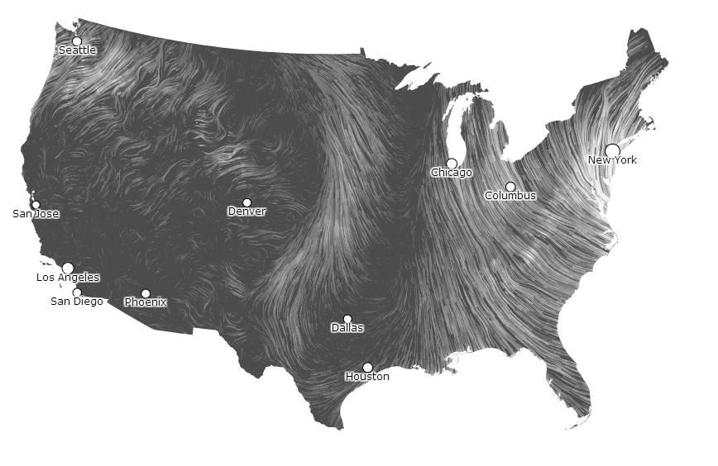
http://hint.fm/wind/

Slide 5
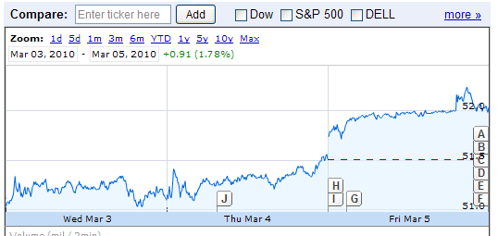
Canonical (time-series) representation
Quantitative
Value
Time

Slide 6
Temporal data – dichotomies
Discrete time versus interval time
Linear time versus cyclic time
Ordinal time versus continuous time
Ordered time versus branching time
Single branch with one ordering versus many possibilities

Slide 7
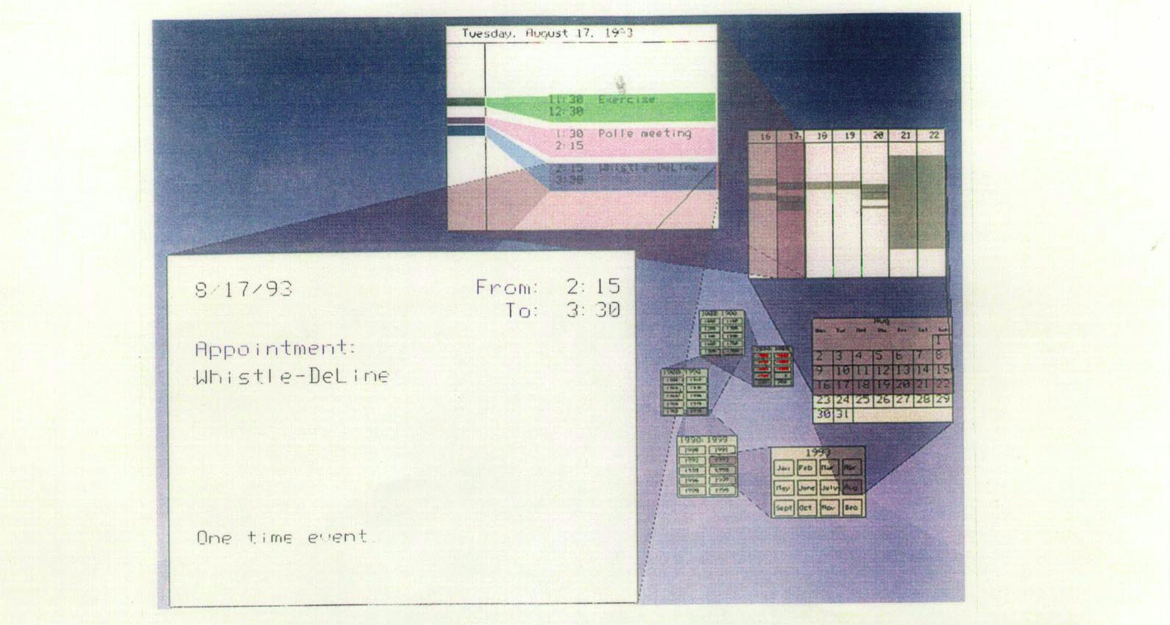
Spiral Calendar
Mackinlay, Robertson & DeLine, UIST’94

Slide 8
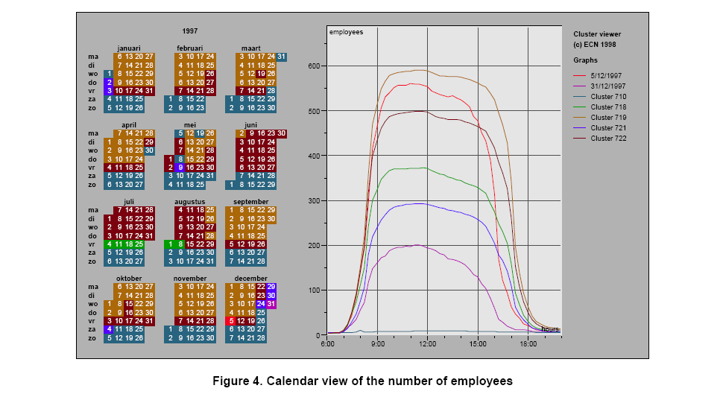
Insights
Traditional office hours followed
Most employees present in late morning
Fewer people are present on summer Fridays
Just a few people work holidays
School vacations occurred May 3-11, Oct 11-19, Dec 21-31
Many people take off day after holiday
Many people leave at 4pm on December 5
Notes:
5th – dutch celebration of santa claus

Slide 9
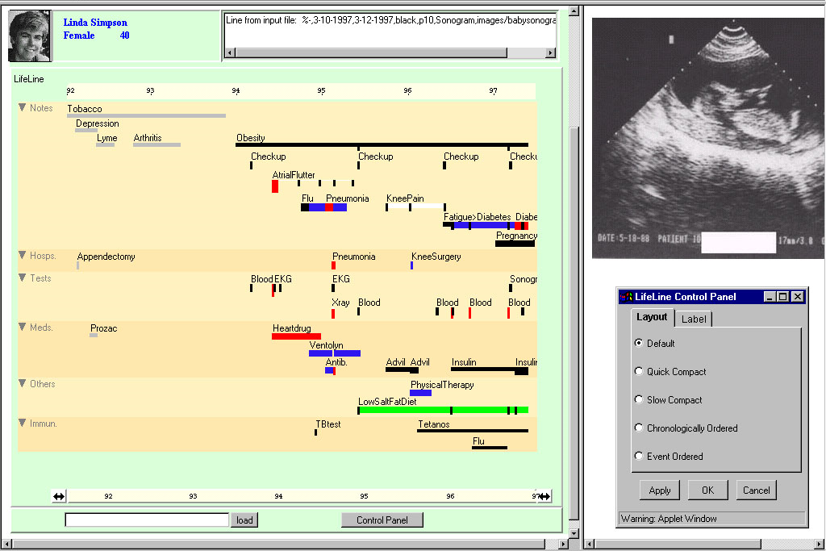
LifeLines, Plaisant et al. (demo at: http://www.cs.umd.edu/hcil/lifelines/latestdemo/chi.html)
Notes:
Put together complete story
Garner information for decision-making
Notice trends
Gain an overview of the events to grasp the big picture

Slide 10
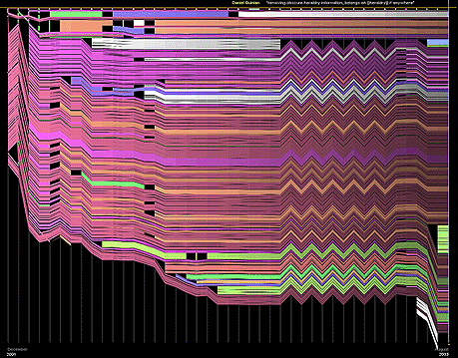
Chocolate page

Slide 11
Case 7
Abstract task:
Find repeating patterns (seasonality) in time series datasets
Isolate the periodicity
Compare aligned time series

Slide 12
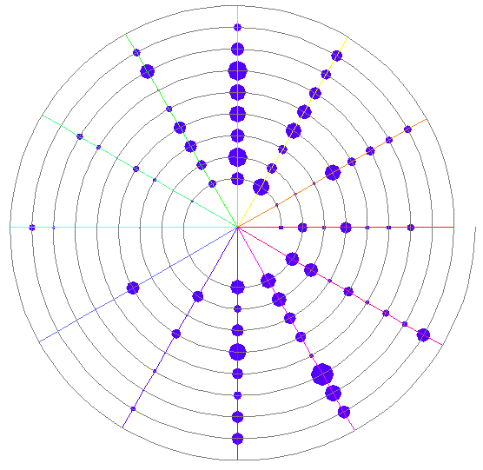
Spiral visualizations
Carlis et al., 1998
Figure 2. An indented spiral, with spokes, showing monthly
consumption percentages for Baphia Capparidifolia during the
period 1980 – 1988.

Slide 13
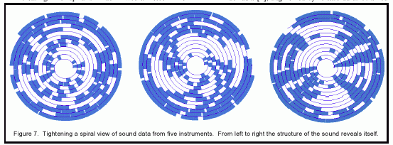
Spiral visualizations
Carlis et al., 1998

Slide 14
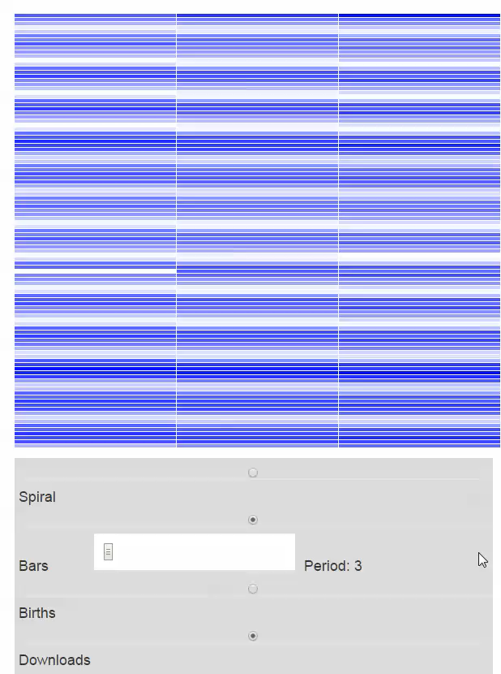
https://eagereyes.org/techniques/spirals

Slide 15
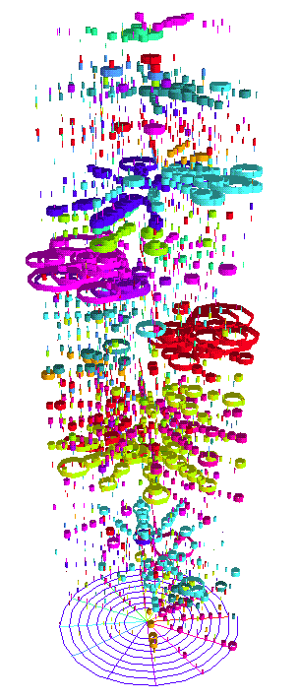
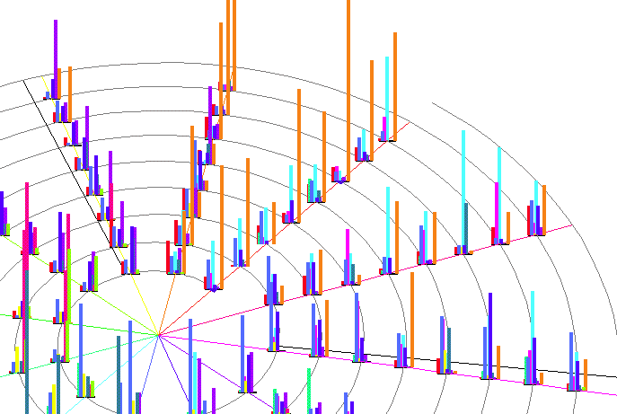
Notes:
112 foods

Slide 16
Summary
Identify the different domain goals
Isolate the tasks (there are many)
Select encodings that support the tasks
Standard types are a good place to start
Additional retinal variables often useful
Some less standard types might also be appropriate
Now for some Pandas…

Slide 17
Today: Temporal data
What is temporal data?
How do we visualize it?
Time series
Clustering
Event-driven analysis
Manipulation
Pandas examples
Analysis
Trends and seasonality
Cross-correlation
Autocorrelation

Slide 18
A few key concepts
“Univariate” time-series
We care about how it breaks down

Slide 19
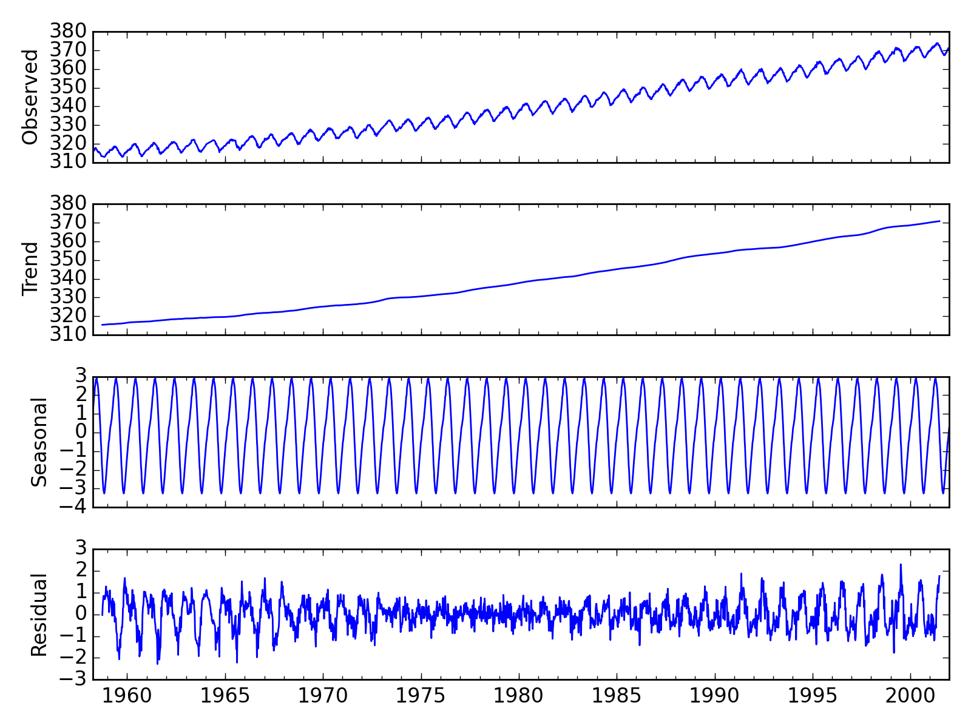

Slide 20
A few key concepts
“Univariate” time-series
We care about how it breaks down
Seasonality, trend, residuals
We care about what value it will take in the future

Slide 21
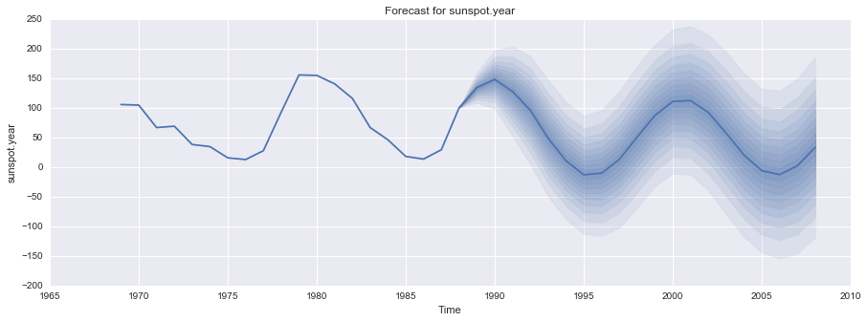
ARIMA model for sunspots
CI
prediction

Slide 22
A few key concepts
“Univariate” time-series
We care about how it breaks down
Seasonality, trend, residuals
We care about what value it will take in the future
For example: ARIMA
Determine parameters (ACF, PACF)

Slide 23
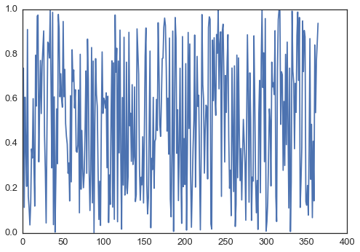
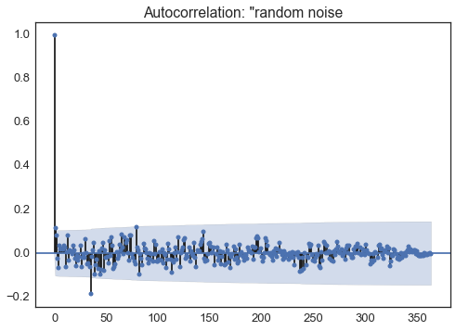
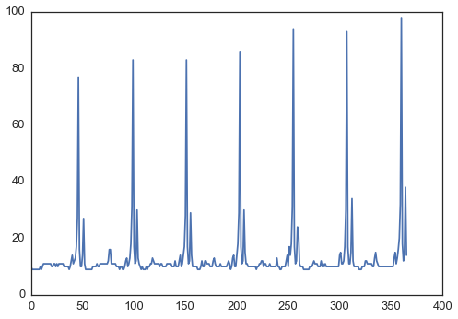
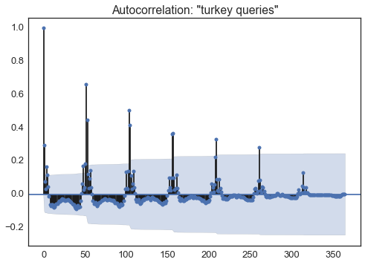
Autocorrelation plot

Slide 24
Auto-correlation
Is the data noise?
Compare the data to itself at different lags
If we only see one “peak” (basically at lag 0)
Random
If we see other peaks/hills
Indication of seasonality
Or that value at t_{n} “depends on value” t_{n-1}

Slide 25
A few key concepts
“Univariate” time-series
We care about how it breaks down
Seasonality, trend, residuals
We care about what value it will take in the future
For example: ARIMA
Some assumptions about this: stationary

Slide 26
(a) Dow Jones index on 292
consecutive days; (b) Daily
change in Dow Jones index on
292 consecutive days; (c)
Annual number of strikes in the
US; (d) Monthly sales of new
one-family houses sold in the US;
(e) Price of a dozen eggs in the
US (constant dollars); (f)
Monthly total of pigs slaughtered
in Victoria, Australia; (g) Annual
total of lynx trapped in the
McKenzie River district of northwest
Canada; (h) Monthly
Australian beer production; (i)
Monthly Australian electricity
production

Slide 27
A few key concepts
“Univariate” time-series
We care about how it breaks down
Seasonality, trend, residuals
We care about what value it will take in the future
For example: ARIMA
Some assumptions about this: stationary
We can make data stationary

Slide 28
A few key concepts
Bi-variate time-series analysis
How related are two time series?
Cross-correlation
A bit like autocorrelation

Slide 29
Cross-Correlation
Works much the same as standard correlation.
corr(x,y) → treats each pair as “point”
t1 → x1,y1; t2 → x2,y2 ; …
One exception:
Lags/delays
Often one series is in advance of other

Slide 30
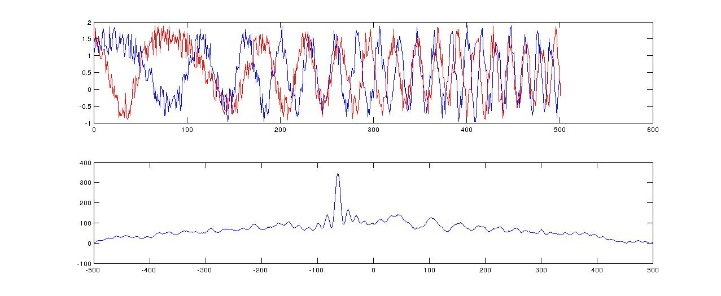

Slide 31
Cross-Correlation
Works much the same as standard correlation.
corr(x,y) → treats each pair as “point”
t1 → x1,y1; t2 → x2,y2 ; …
One exception:
Lags/delays
Often one series is in advance of other
We can include a “lag”
Often part of utility function… provide min/max lag
Find max value (above some critical point)

Slide 32
Cross correlation plot
correlation
lag

Slide 33
Danger…

Slide 34
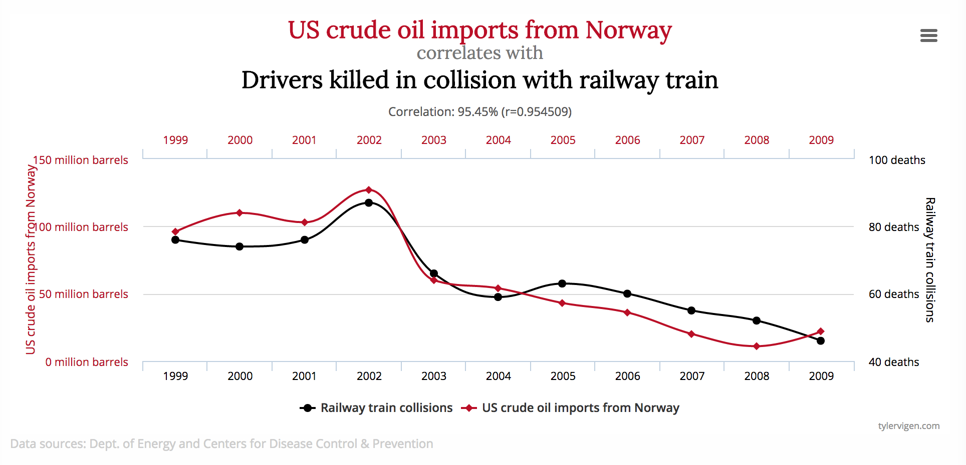
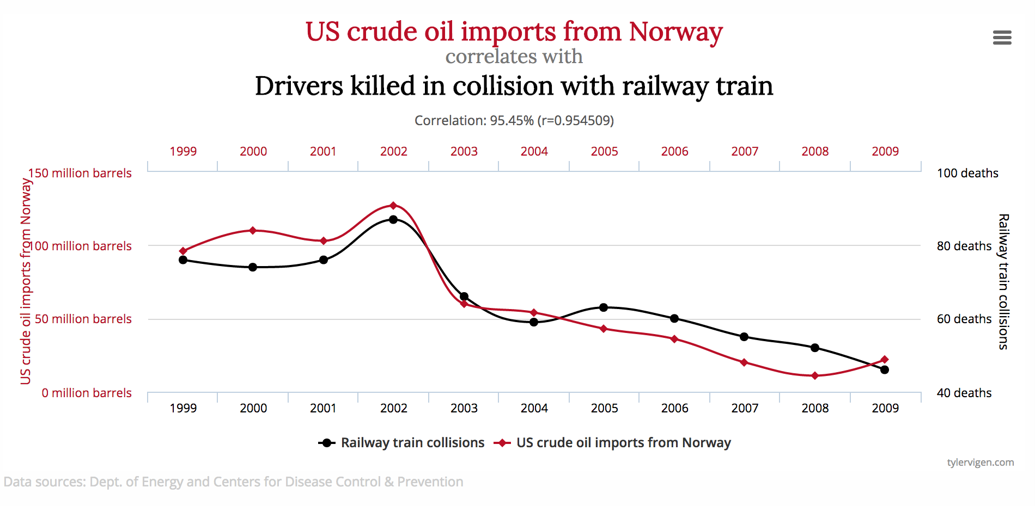
http://www.tylervigen.com/spurious-correlations

Slide 35
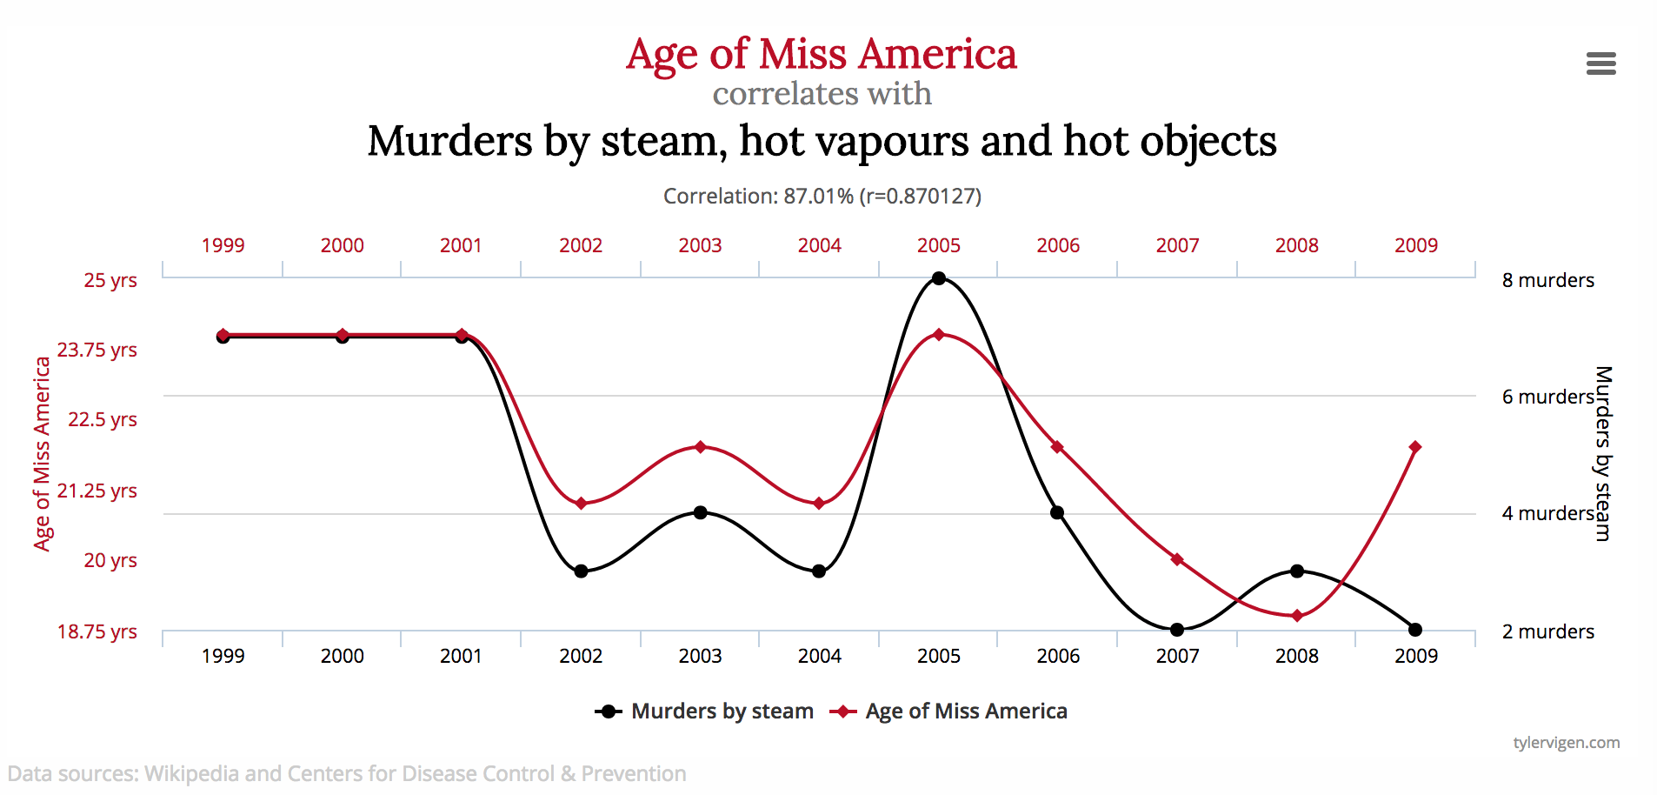
http://www.tylervigen.com/spurious-correlations

Slide 36
Summary
Temporal data sets are ubiquitous
Need to carefully consider the problem
Different ways to structure the data
Different ways to do EDA
Visual forms and statistical
Statistics are wonky… data needs to be “cleaned” differently than other datasets
Now… more Pandas

